Slide 1
Conic Sections
Circles, Ellipses, Hyperbolas & Parabolas

Slide 2
Conic Sections
Conic sections (or “conics”) are special equations that are not functions
They all can be made from cutting cones, hence the name
There are 3 (or 4) types:
Ellipses (circles are a special case)
Hyperbolas
Parabolas

Slide 3
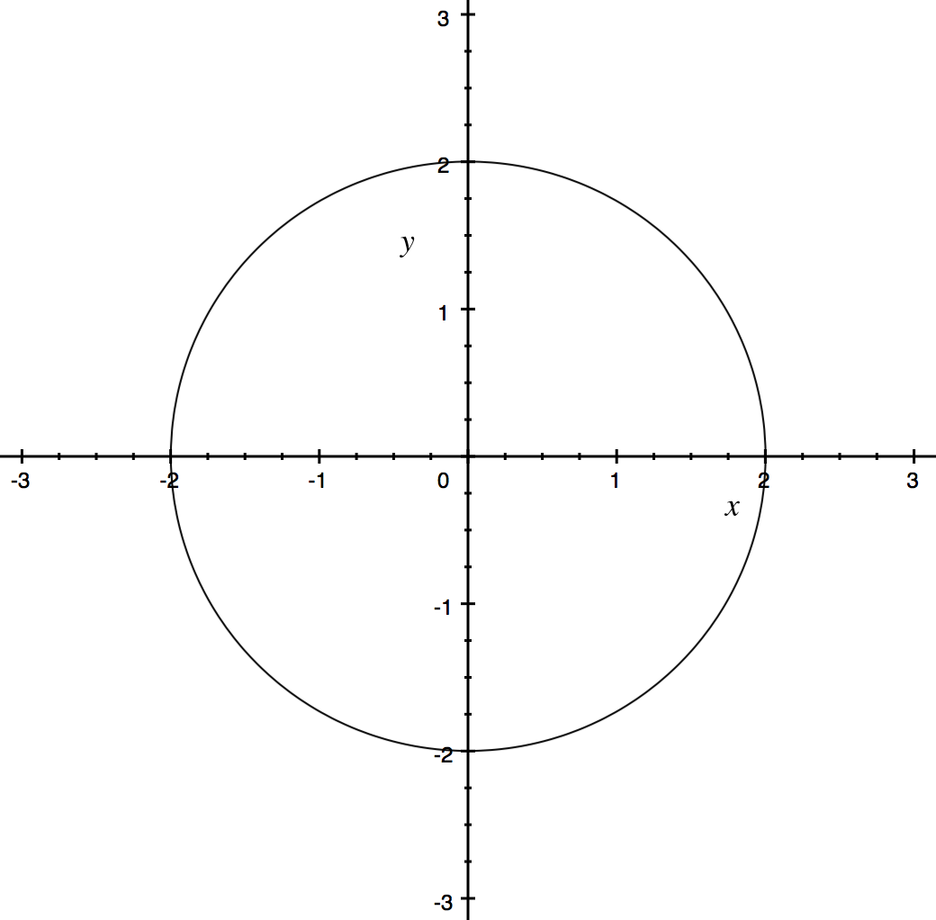
Conic Sections – Circles
The equation is of the form
where the center is at $(a, b)$ and the radius is $r$.
$${\left(x−a\right)}^{2}+{\left(y−b\right)}^{2}=r^{2}$$
The parametric form of the equation is
$$x=r\cos{θ+a}$$
$$y=r\sin{θ}+b$$

Slide 4
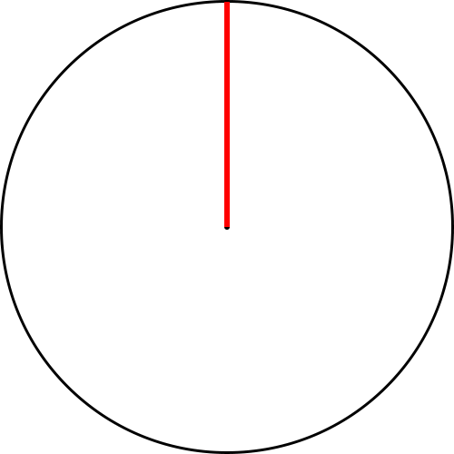
Conic Sections – Circles
Circles are formed by rotating a point at a fixed distance from the center.

Slide 5
Example 1
What is the equation of this circle?
The center is at $(2, −1)$
The radius is $2$
$$(2, −1)$$
$${\left(x−2\right)}^{2}+{\left(y+1\right)}^{2}=4$$

Slide 6
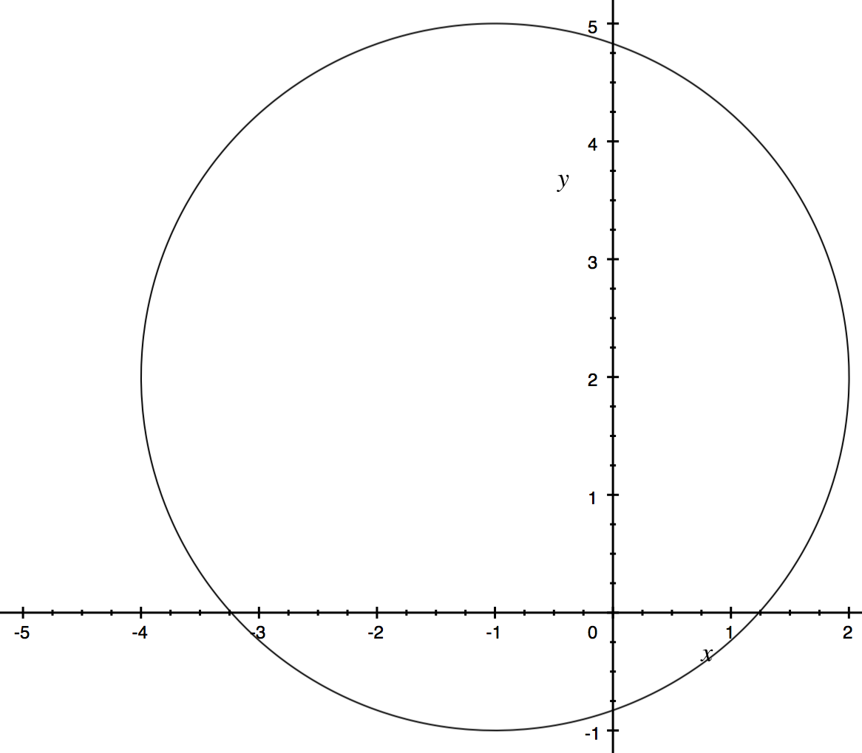
Example 2
Draw the circle given by the equation
$$x^{2}+y^{2}+2x−4y −4=0$$
$$x^{2}+2x+y^{2}−4y −4=0$$
$${\left(x+1\right)}^{2}−1+{\left(y−2\right)}^{2}−4−4=0$$
$${\left(x+1\right)}^{2}+{\left(y−2\right)}^{2}−9=0$$
$$(−1, 2)$$
$${\left(x+1\right)}^{2}+{\left(y−2\right)}^{2}=9$$
The center is at $(−1, 2)$
The radius is $3$

Slide 7
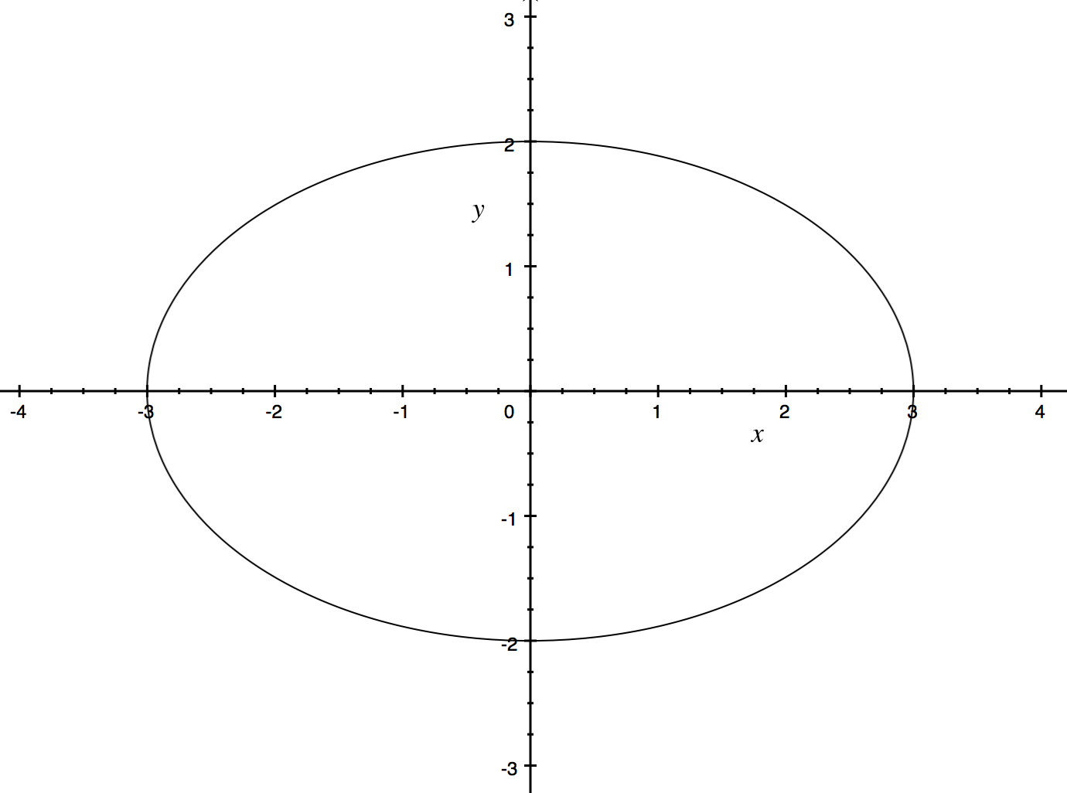
Conic Sections – Ellipses
The long axis is called the semi-major axis, and the short axis is called the semi-minor axis.
The equation is of the form
where the center is at $(a, b)$ , the $x$-radius is $r_{1}$, and the $y$-radius is $r_{2}$.
$$\frac{{\left(x−a\right)}^{2}}{r_{1}^{2}}+\frac{{\left(y−b\right)}^{2}}{r_{2}^{2}}=1$$
The parametric form of the equation is
$$x=r_{1}\cos{θ}+a$$
$$y=r_{2}\sin{θ}+b$$
Notes:
Semi-major is longer than semi-minor

Slide 8
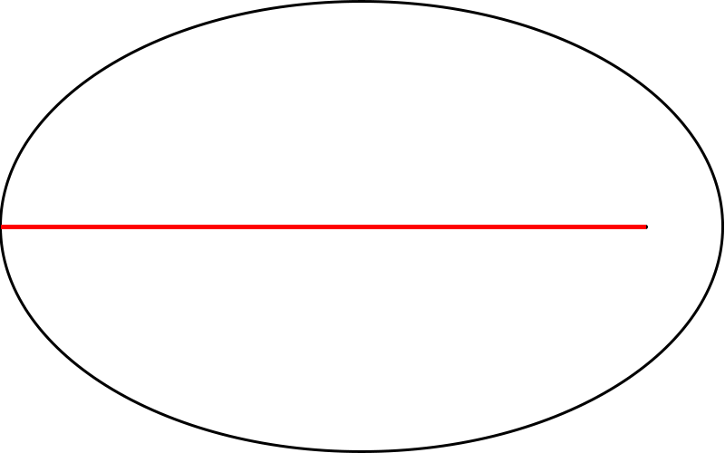
Conic Sections – Ellipses
Ellipses are formed by drawing two connected lines from the foci, where the sum of the two lines is constant.

Slide 9
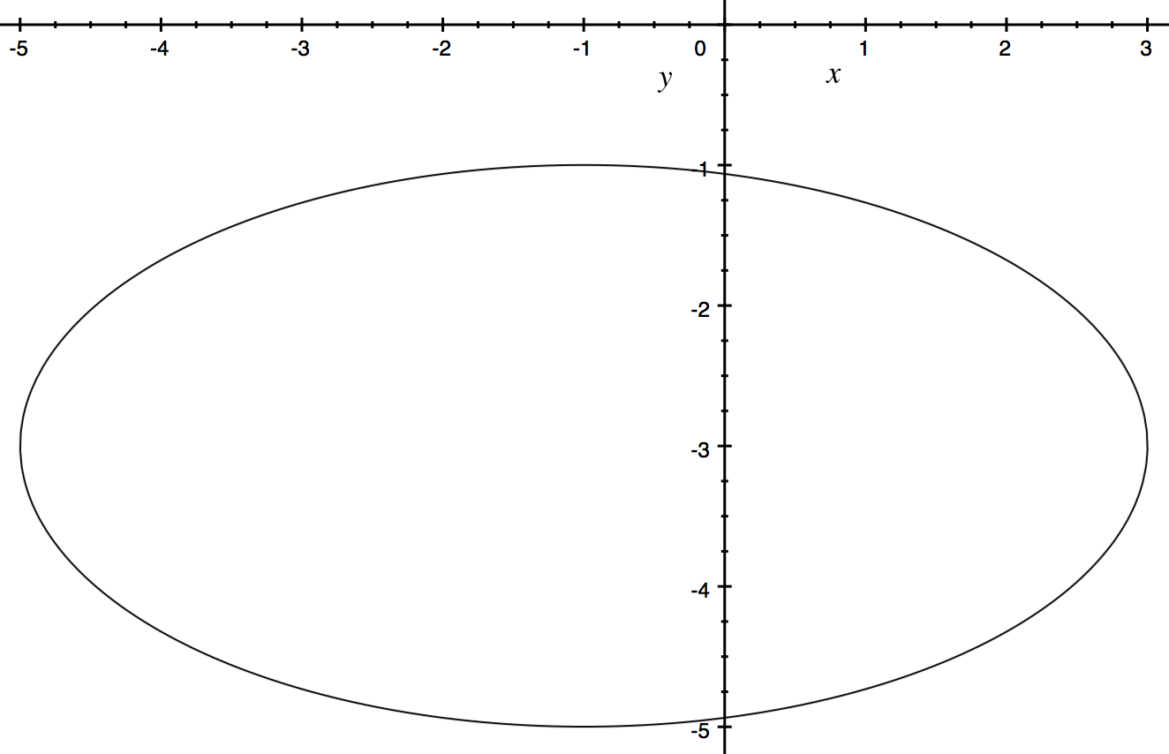
Example 1
What is the equation of this ellipse?
The center is at $\left(−1, −3\right)$
The $x$-radius is $4$
The $y$-radius is $2$
$$(−1, −3)$$
$$\frac{{\left(x+1\right)}^{2}}{16}+\frac{{\left(y+3\right)}^{2}}{4}=1$$

Slide 10
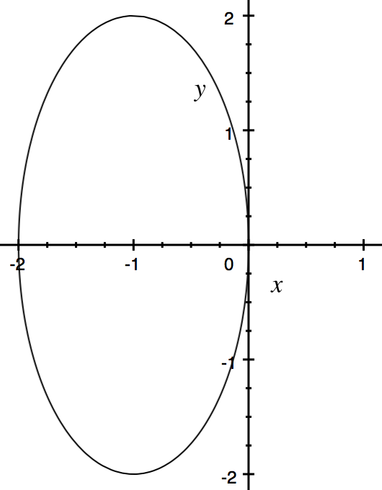
Example 2
Draw the conic section given by
$${4x}^{2}+y^{2}+8x=0$$
$${4x}^{2}+8x +y^{2}=0$$
$${4(x}^{2}+2x)+y^{2}=0$$
$$4\left({\left(x+1\right)}^{2}−1\right)+y^{2}=0$$
$$4{\left(x+1\right)}^{2}+y^{2}=4$$
The $x$-radius is $1$
$${\left(x+1\right)}^{2}+ \frac{y^{2}}{4}=1$$
The $y$-radius is $2$
The center is at $(−1, 0)$

Slide 11
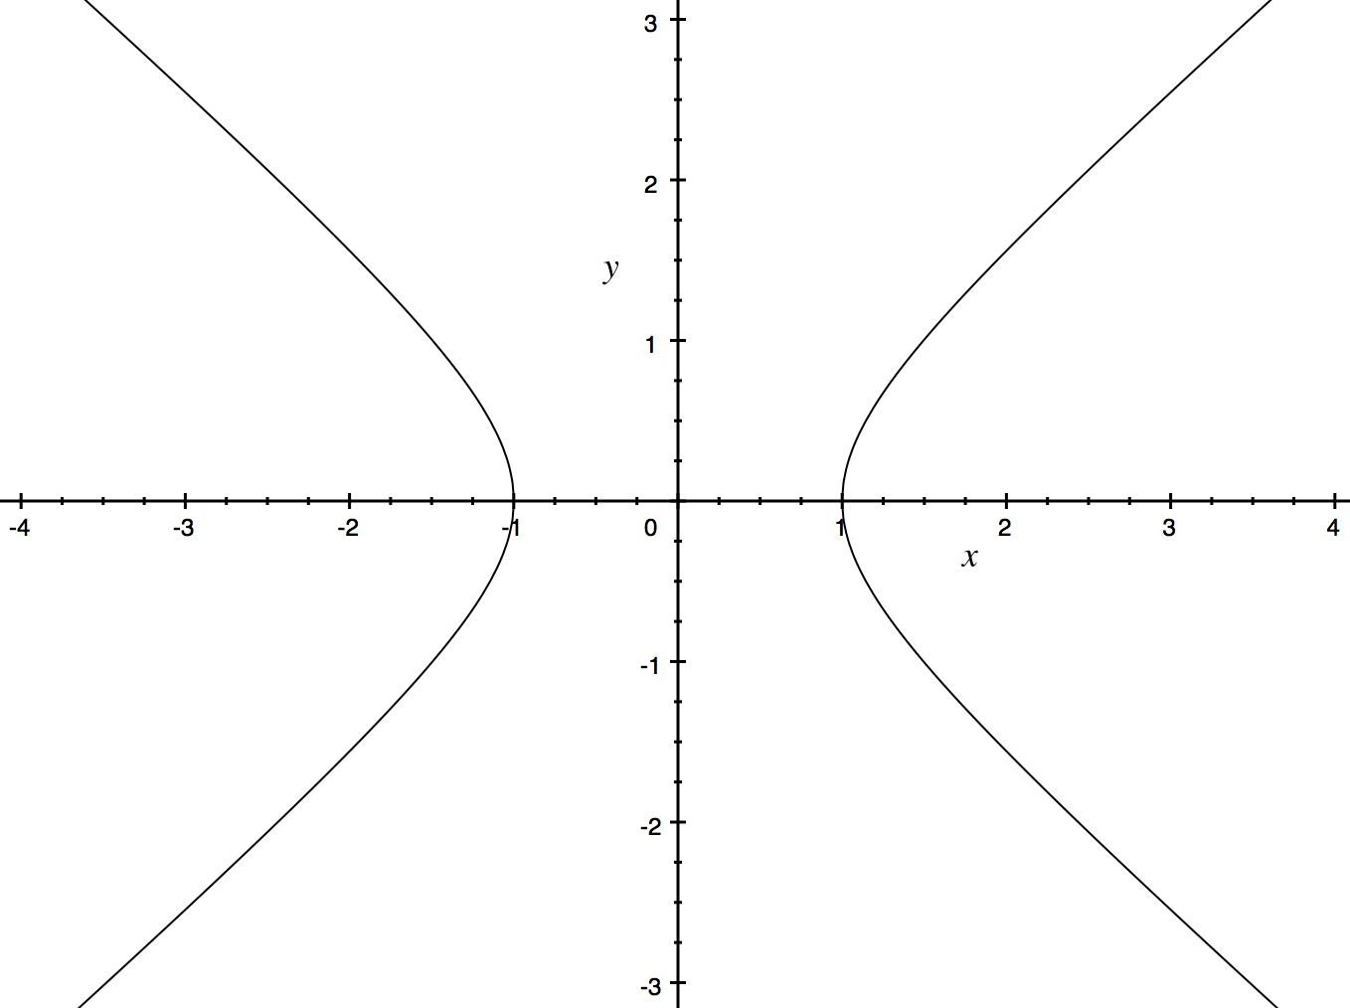
Conic Sections – Hyperbolas
The equation is of the form
where the center is at $\left(a, b\right)$, the arms start $r_{1}$ along the $x$-axis, and the asymptotes have gradient $±\frac{r_{2}}{r_{1}}$.
$$\frac{{\left(x−a\right)}^{2}}{r_{1}^{2}}−\frac{{\left(y−b\right)}^{2}}{r_{2}^{2}}=1$$
The parametric form of the equation is
$$x=r_{1}\sec{θ+a}$$
$$y=r_{2}\tan{θ}+b$$

Slide 12
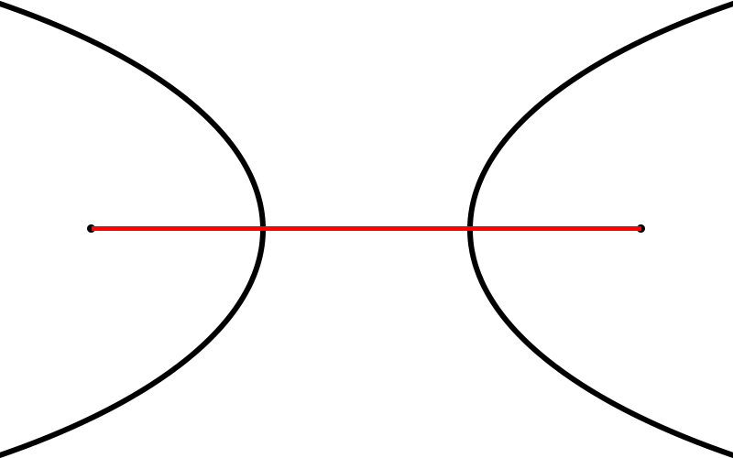
Conic Sections – Hyperbola
A hyperbola is formed by drawing two connected lines from the two foci, where the difference in lengths of the lines is a constant.

Slide 13
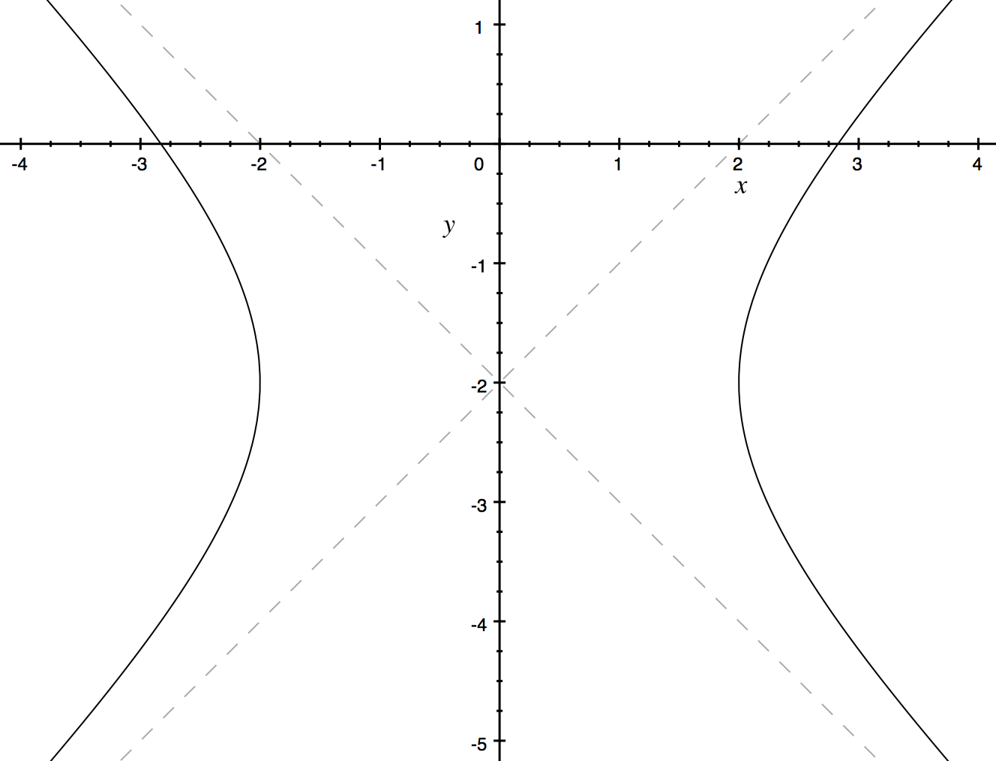
Example 1
What is the equation of the hyperbola?
Center is $(0, −2)$
Distance to arm is $2$
Gradient of asymptotes is $±1$
$$\frac{x^{2}}{4}−\frac{{\left(y+2\right)}^{2}}{4}=1$$

Slide 14
Example 2
A hyperbola has two asymptotes that meet at $(2, −1)$. One has the equation $y=\frac{4x−13}{5}$. The Hyperbola passes through $(4.5, −1)$.
What is the equation of the hyperbola?
$$\frac{{\left(x−2\right)}^{2}}{r_{1}^{2}}−\frac{{\left(y+1\right)}^{2}}{{\left(\frac{4r_{1}}{5}\right)}^{2}}=1$$
$$\frac{{\left(x−2\right)}^{2}}{r_{1}^{2}}−\frac{{25\left(y+1\right)}^{2}}{{16r}_{1}^{2}}=1$$
$${\left(x−2\right)}^{2}−\frac{{25\left(y+1\right)}^{2}}{16}=r_{1}^{2}$$
$${\left(4.5−2\right)}^{2}−\frac{{25\left(−1+1\right)}^{2}}{16}=r_{1}^{2}$$
$$\frac{r_{2}}{r_{1}}=\frac{4}{5}⇒r_{2}=\frac{4r_{1}}{5}$$
$${\left(4.5−2\right)}^{2}=r_{1}^{2}$$
$$2.5=r_{1}$$

Slide 15
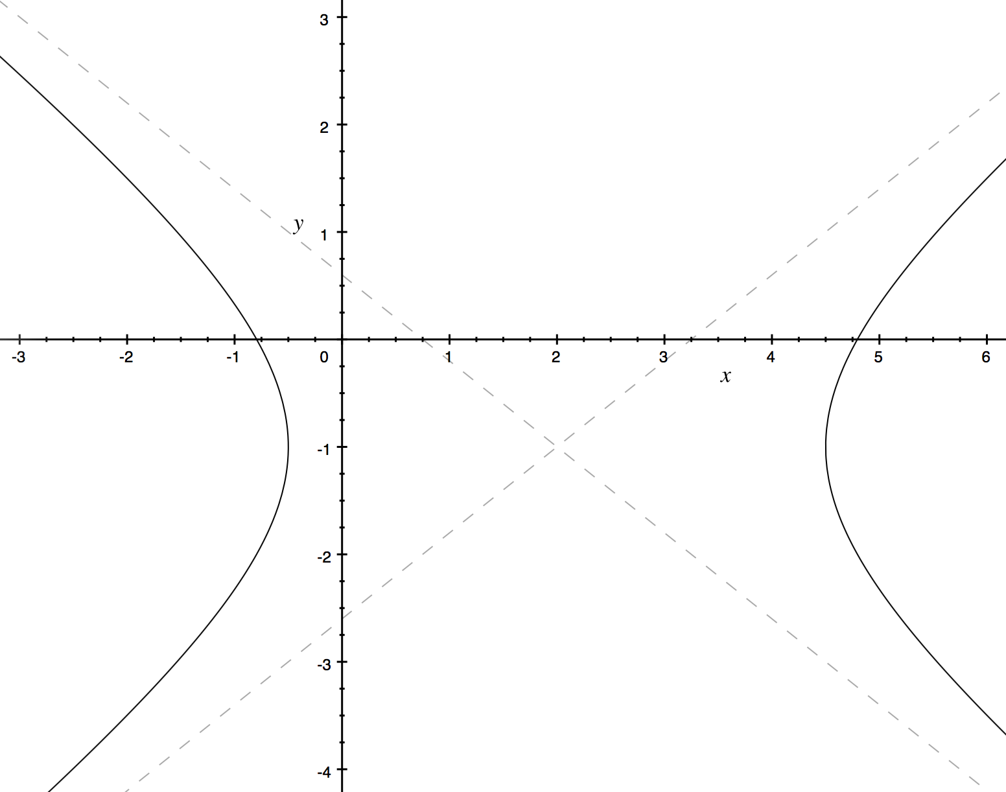
Example 2
$$r_{2}=\frac{4r_{1}}{5}$$
$$r_{1}=\frac{5}{2}$$
$$r_{2}=\frac{4}{5}×\frac{5}{2}=2$$
$$\frac{{\left(x−2\right)}^{2}}{r_{1}^{2}}−\frac{{\left(y+1\right)}^{2}}{r_{2}^{2}}=1$$
$$\frac{{2^{2}\left(x−2\right)}^{2}}{5^{2}}−\frac{{\left(y+1\right)}^{2}}{2^{2}}=1$$
$$\frac{{4\left(x−2\right)}^{2}}{25}−\frac{{\left(y+1\right)}^{2}}{4}=1$$

Slide 16
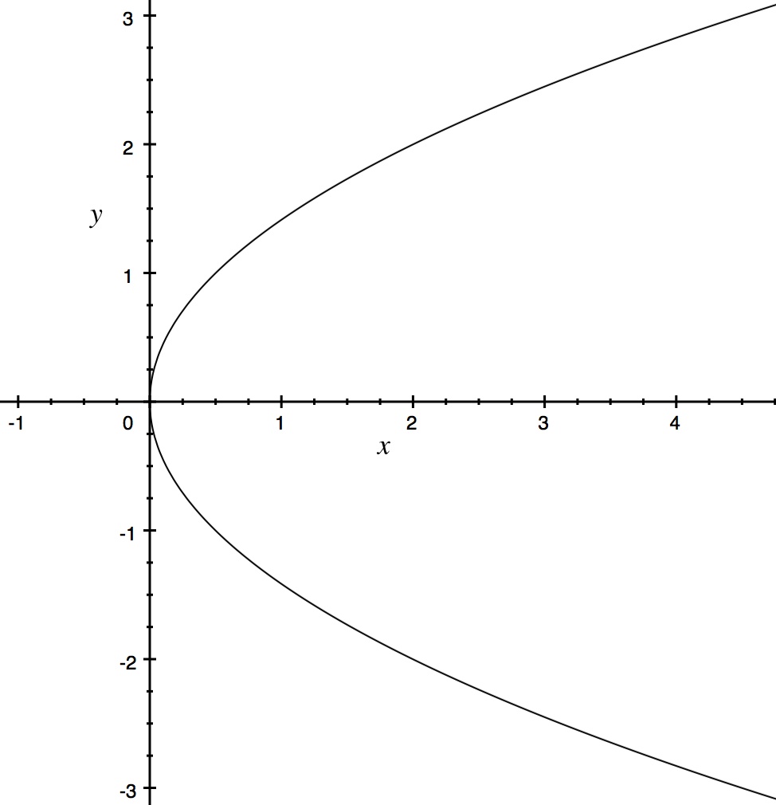
Conic Sections - Parabolas
The equation is of the form
where the origin is at $\left(b, c\right)$, the focus is at $(c,a+b)$and the directrix is $x=b−a$.
$${\left(y−c\right)}^{2}=4a(x−b)$$
The parametric form of the equation is
$$x=at^{2}+b$$
$$y=2at+c$$
Notes:
Directrix is the line that sits behind the parabola that is the same distance from the curve as the focus.

Slide 17
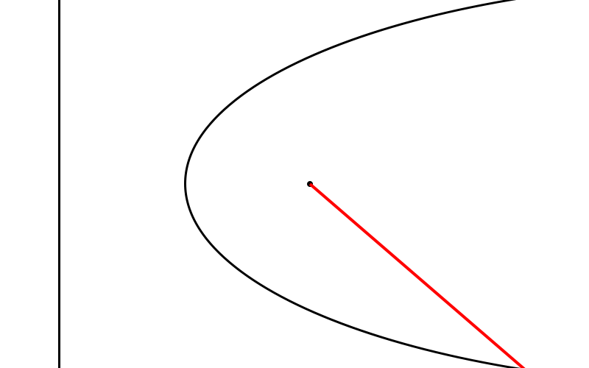
Conic Sections – Parabolas
A parabola is formed by drawing a line from the focus, and a connected equal length line perpendicular to the directrix.

Slide 18
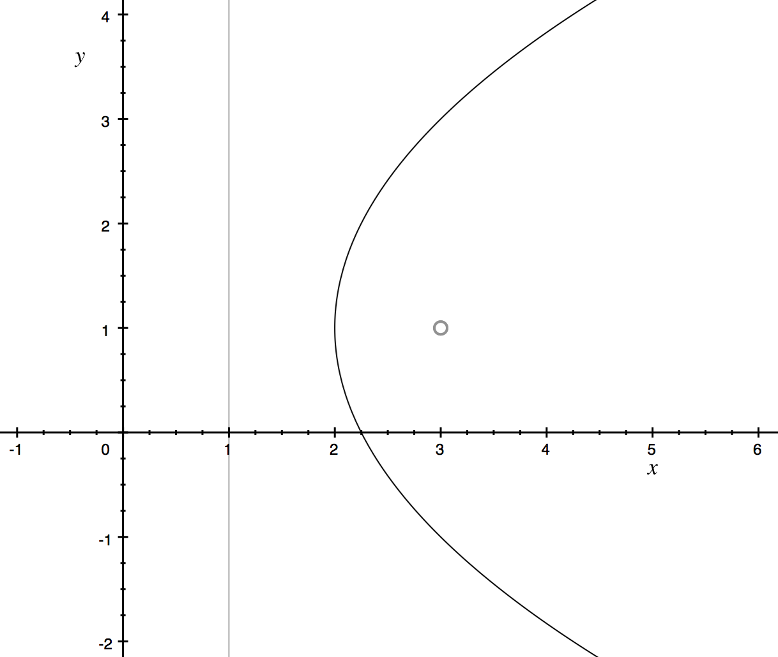
Example 1
What is the equation of this parabola?
The origin of the parabola is at $(2,1)$.
The parabola passes through $(3,3)$.
$$(3, 3)$$
$${\left(y−1\right)}^{2}=4a(x−2)$$
$${\left(3−1\right)}^{2}=4a(3−2)$$
$$4=4a$$
$$a=1$$
$${\left(y−1\right)}^{2}=4x−8$$

Slide 19
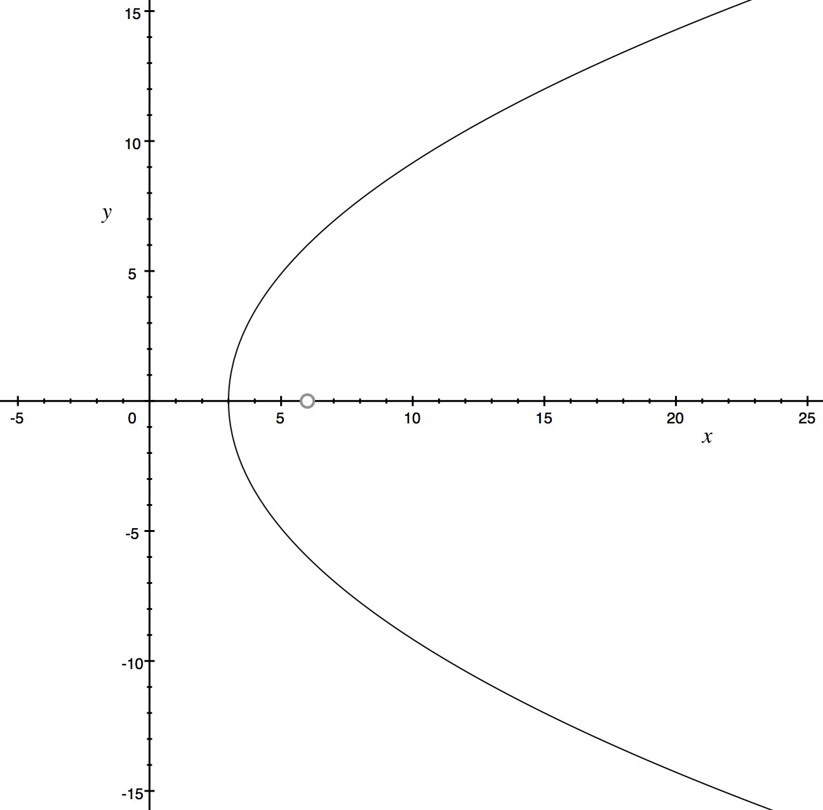
Example 2
The focus of the parabola is at $(6, 0)$ and the $y$-axis serves as the directrix. What is the equation of the parabola?
The origin of the parabola sits halfway between the focus and the directrix: $(3, 0)$
The distance to the focus from the origin is $a=3$
$$y^{2}=4×3(x−3)$$
$$y^{2}=12x−36$$

Slide 20
Example 3
Prove that
are the parametric form of a parabola.
$$x=at^{2}+b$$
$$y=2at+c$$
$$t=\frac{y−c}{2a}$$
$$(x−b)=a\frac{{\left(y−c\right)}^{2}}{4a^{2}}$$
$$x=a{\left(\frac{y−c}{2a}\right)}^{2}+b$$
$$4a(x−b)={\left(y−c\right)}^{2}$$

Slide 21
Practice
Delta Workbook
Exercises 37.1 – 37.6, pages 358-374
Workbook
Conics are used as applications in several sections
You are not expected to be able to do all of these applications now
Pages 32-35, 47-55, 217-219, 227-232

Slide 22
Do Now
Any Questions?
Delta Workbook
Exercise 37.1-37.6
Workbook
Some of pages 32-35, 47-55, 217-219, 227-232

Slide 23
This work is licensed under a Creative Commons Attribution-NonCommercial-ShareAlike 4.0 International License.
Aaron Stockdill
2016

