Slide 1
Preliminaries
Notation, Long Division & The Formula Sheet

Slide 2
Notation
$$ℝ$$
Real Numbers
$$ℤ$$
Integers
$$ℚ$$
Rational Numbers (Fractions)
$$ℕ$$
Natural Numbers (With NO zero)
$$ℂ$$
Complex Numbers
Notes:
Symbols they may not have seen before
The book says Naturals start at 1. I think this is less correct (see ZF Set Theory and Computer Science), but there is no agreed-upon definition.

Slide 3
Notation
$$\{x :rule\}$$
Build a set of $x$s that match the $rule$.
$$x∈A$$
$x$ is an element of $A$ (i.e. $x$is in $A$)
$$A⊆B$$
$A$is a subset of $B$ (i.e. everything in $A$ is also in $B$)
$$A∩B$$
$A$intersect $B$(i.e. everything that is in both $A$and $B$)
$$A∪B$$
$A$union $B$(i.e. everything in $A$or $B$, or both)
Notes:
Symbols they may not have seen before
Sometimes {x : rule} is written {x | rule}

Slide 4
Example
Is $5∈ℤ$?
Is $5∈ℚ$?
What is $\left\{x :x∈ℤ, x \text{is} \text{even}\right\}∩\left\{1, 2, 3, 4, 5\right\}$?
What is $ℤ∪ℚ$?
Using this, which of these is true?
$ℤ=ℚ ℤ⊆ℚ ℤ⊇ℚ$
Yes
Yes
$$\{2, 4\}$$
$$ℚ$$
Notes:
5 is the same as 5/1

Slide 5
Practice
Workbook
Have a look at the domain and range questions on page 13

Slide 6
Long Division
The ”traditional” version of Synthetic Division
You will see synthetic division in the book, and in class
We will cover long division as it has fewer restrictions

Slide 7
Example 1
$$x^{2}$$
$$− 6$$
$$x −2$$
$$x^{3}−2x^{2} −6x+12$$
$${−(x}^{3}−2x^{2})$$
$$0 −6x+12$$
$$−(− 6x+12)$$
$$0$$
Thus $(x^{3}−2x^{2}−6x+12)÷\left(x −2\right)$ is $x^{2}−6$.

Slide 8
Example 2
$$3x^{2}$$
$$−2x$$
$$−4$$
$$3x+2$$
$$9x^{3}+0x^{2}−16x−10$$
$$−(9x^{3}+6x^{2})$$
$$−6x^{2}−16x$$
$$−(−6x^{2}− 4x)$$
$$−12x−10$$
$$−(−12x− 8)$$
$$−2$$
Thus $\left(9x^{3}−16x−10\right)÷(3x+2)$ is $3x^{2}−2x−4−\frac{2}{3x+2}$.

Slide 9
Practice
Delta Workbook
Exercise 26.1, page 237
Workbook
Try the synthetic division questions using long division, pages 2-3

Slide 10
Formula Sheet
Your precious…

Slide 12
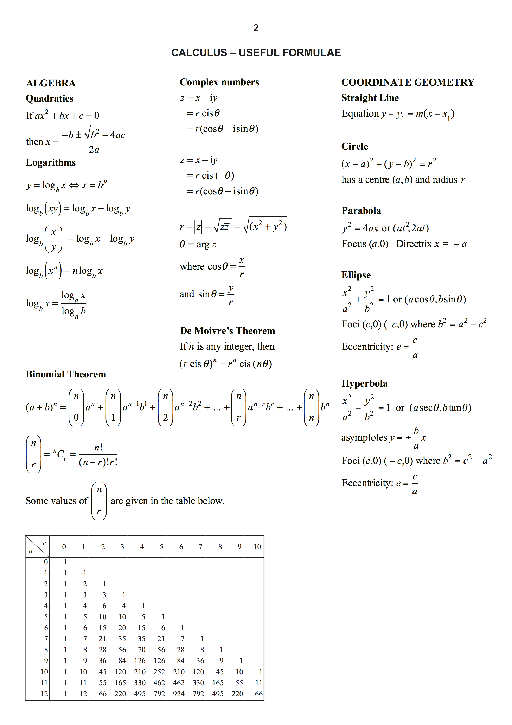
Generally Useful
Complex Numbers
Conics
???

Slide 13
Differentiation
Integration

Slide 14
Generally Useful
Magic Triangles
Trigonometry
Shapes

Slide 15
Do Now
Any Questions?
Delta Workbook
Exercise 26.1, page 237
Workbook
Try the synthetic division questions using long division, pages 2-3
Try the domain and range questions on page 13

Slide 16
This work is licensed under a Creative Commons Attribution-NonCommercial-ShareAlike 4.0 International License.
Aaron Stockdill
2016

